Slide 1
(various) Machine Learning Project(s)
Lee Taber, Sean Fernandes, Kevin Weatherwax

Slide 2
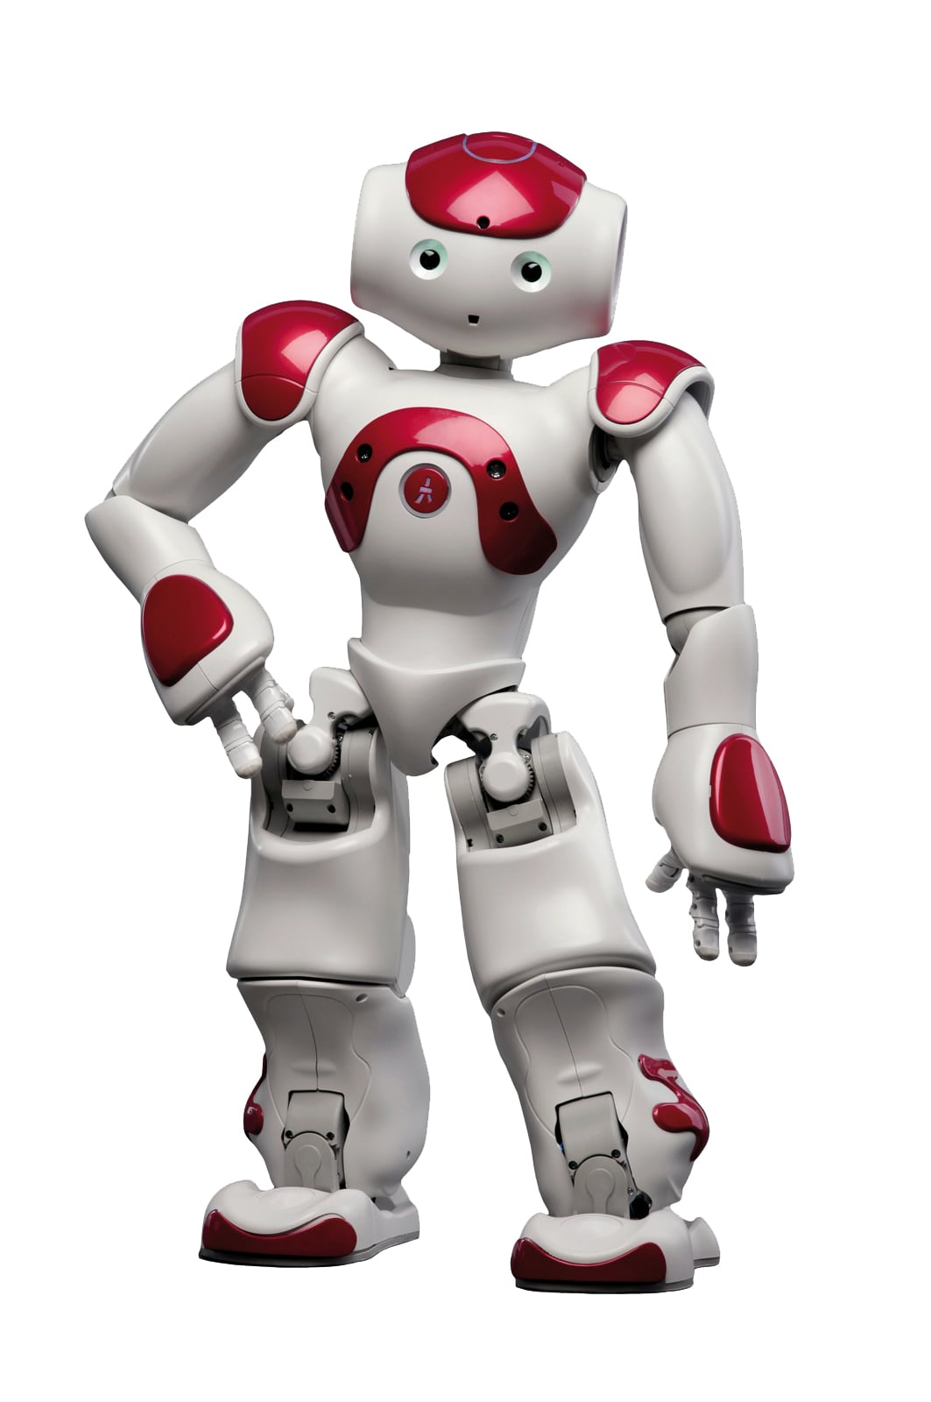
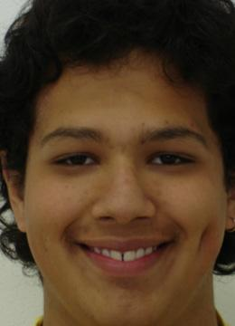
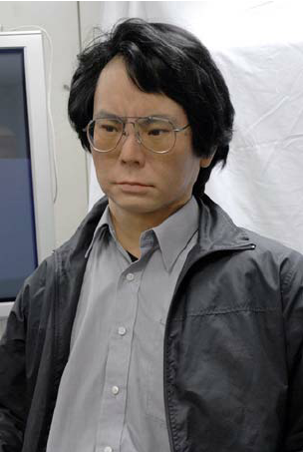

Image Classification
Motivation: As robots become more robust there is concern they will replace humans on a wide scale.
Goal: Detect robots disguised as humans
Datasets:
The Anthropomorphic Robot (ABOT) Database*
Brazilian face database (FEI Database**)
Can you tell which is a robot and which is a human?
How about now?
*http://www.abotdatabase.info
** https://fei.edu.br/

Slide 3
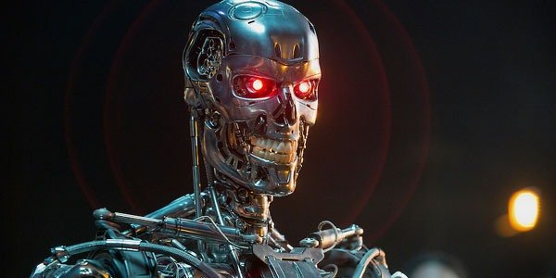
Human or Robot?
99.15%Robot
Ok pretty good.
How about something less obvious

Slide 4
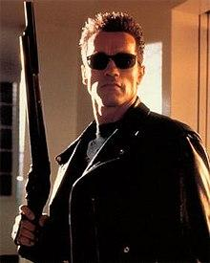
Human or Robot?
Does this mean it is good? Can it detect a human who is so in character (due to amazing acting talent) that they have become a robot?
Is Arnold Shwaretenager the greatest actor of all time?
99.8%Robot
Nailed it!

Slide 5
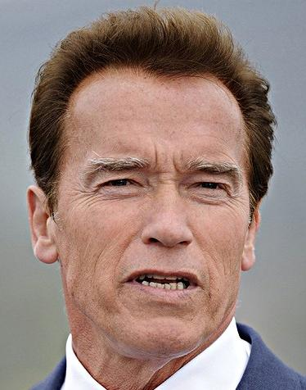
Human or Robot?
99.89% Human
Perfect score!

Slide 6
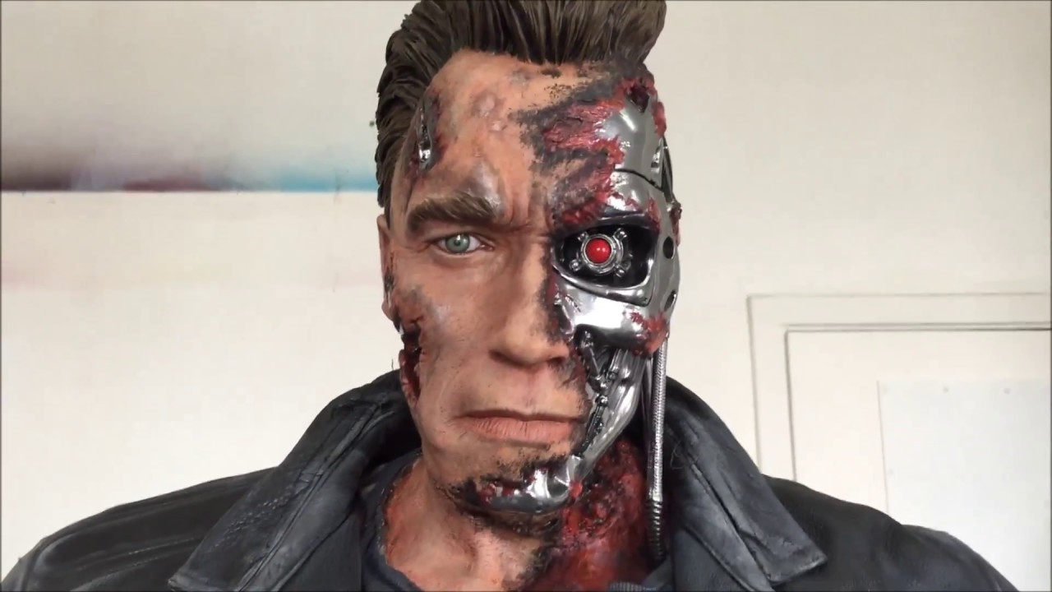
Human or Robot?
99.63%Human
Arnold Torn Face
. . . !

Slide 7
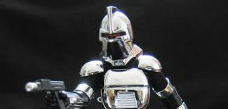
Human or Robot?
100%
Robot
Old Cylon
Wowza!

Slide 8
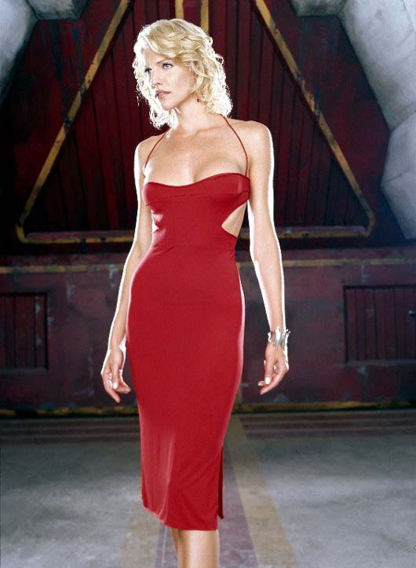
Human or Robot?
99.8%
Robot
Hot Cylon
Good Job!

Slide 9
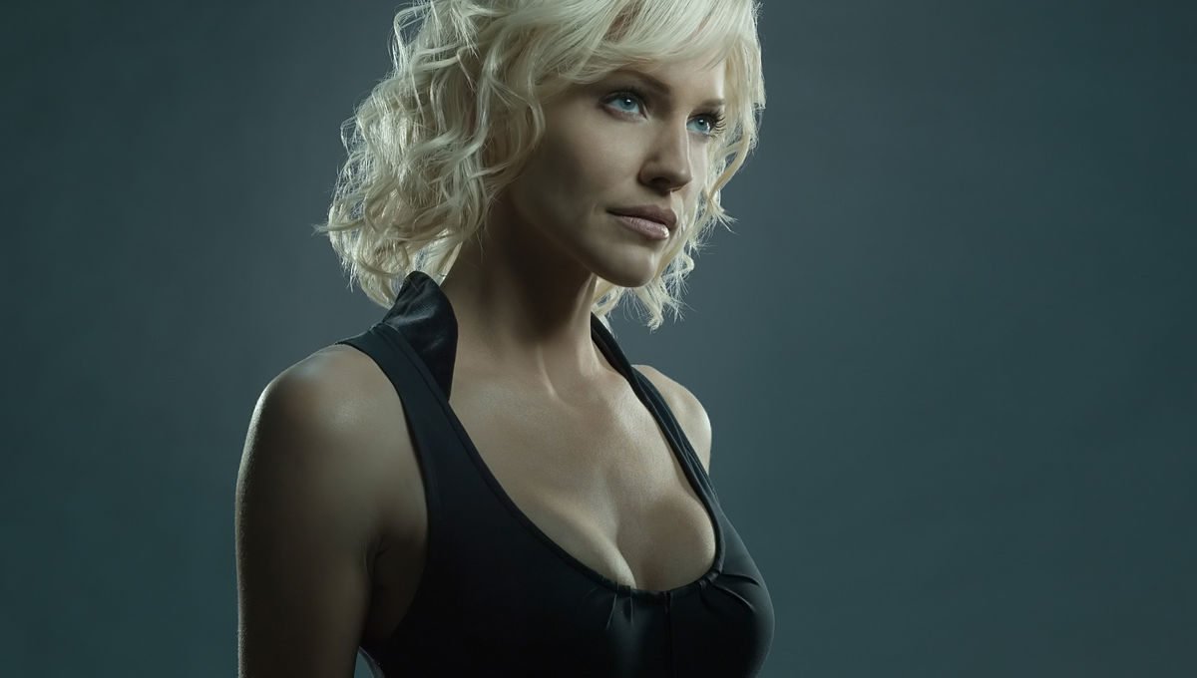
Human or Robot?
84.68%Human
Cylon Actress Headshot
Amazing!

Slide 10
Human or Robot?
Real Human
CYLON
Some Dick
71.89% Human
72.68% Robot

Slide 11
Text Classification
Assign OCEAN values to text
Openness, Conscientiousness, Extroversion, Agreeableness, Neuroticism
Use these values to generate text with specific OCEAN values
Dataset:
Mypersonality, ~10,000 status updates with accompanying OCEAN personality ratings

Slide 12
Text Classification
Assign OCEAN values to text
Use these values to generate text with specific OCEAN values
Dataset:
Mypersonality, ~10,000 status updates with accompanying OCEAN personality ratings
Example
STATUS | sEXT | sNEU | sAGR | sCON | sOPN
likes the sound of thunder. | 2.65 | 3 | 3.15 | 3.25 | 2.55

Slide 13
Text Classification
Assign OCEAN values to text
Use these values to generate text with specific OCEAN values
Dataset:
Mypersonality, ~10,000 status updates with accompanying OCEAN personality ratings
Example
Haven’t figured out how to get it to work though...
STATUS | sEXT | sNEU | sAGR | sCON | sOPN
likes the sound of thunder. | 2.65 | 3 | 3.15 | 3.25 | 2.55

Slide 14
Text Classification
Assign OCEAN values to text
Use these values to generate text with specific OCEAN values
Dataset:
Mypersonality, ~10,000 status updates with accompanying OCEAN personality ratings
Example
Haven’t figured out how to get it to work though...
STATUS | sEXT | sNEU | sAGR | sCON
likes the sound of thunder. | 2.65 | 3 | 3.15 | 3.25
CYLON

Slide 15

Text Classification
Relationship to larger research
Ideally, would like to use this to help create posts that exhibit certain personality traits (i.e. here are a bunch of posts from an Extroverted “person”)
Would allow for a more robust simulated social media
Otherwise, have to write a lot of posts and comments by hand

Slide 16
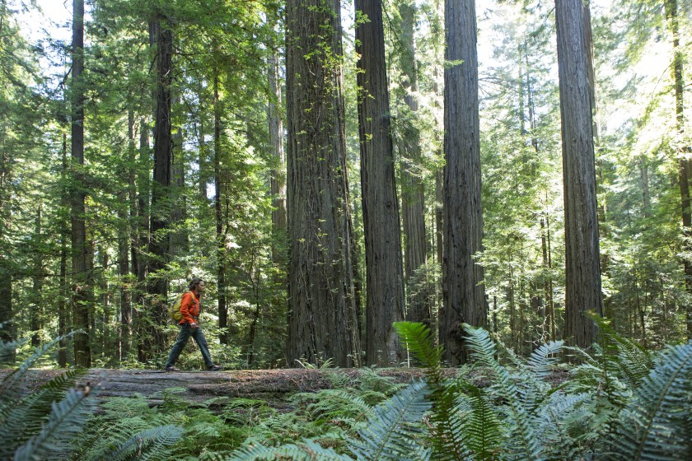
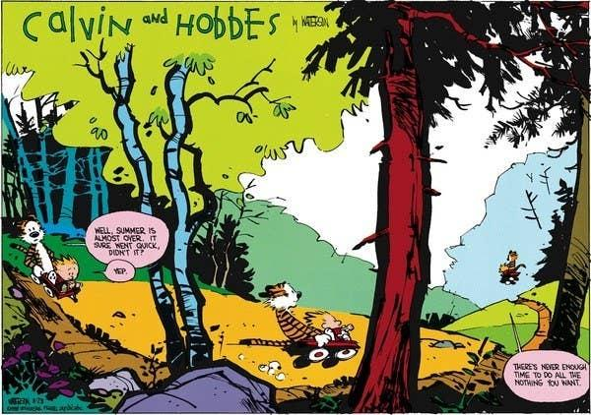
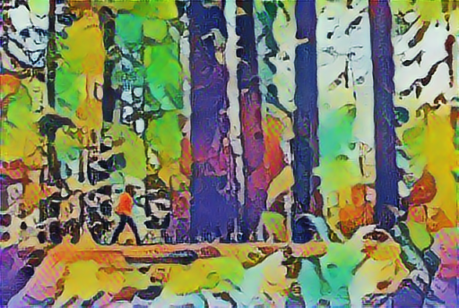

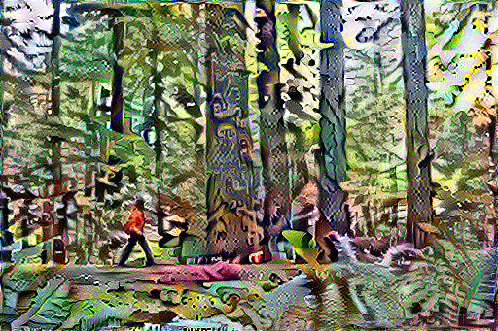
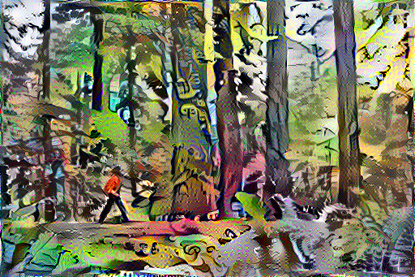
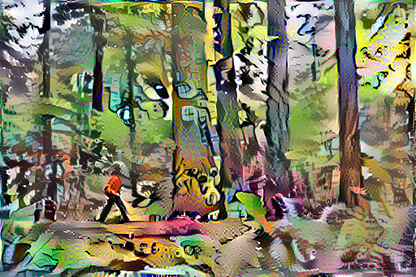
We also did some style transfer… how pretty
Using TensorFlow Cores Neural Style Transfer, Fast Model (Above) Full Model (Below)
Gradient Descent
500 steps
1000 steps
W/ Total Variation Loss

Slide 17
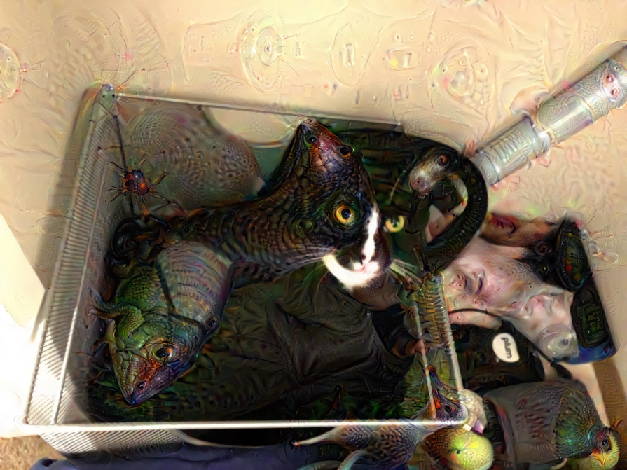
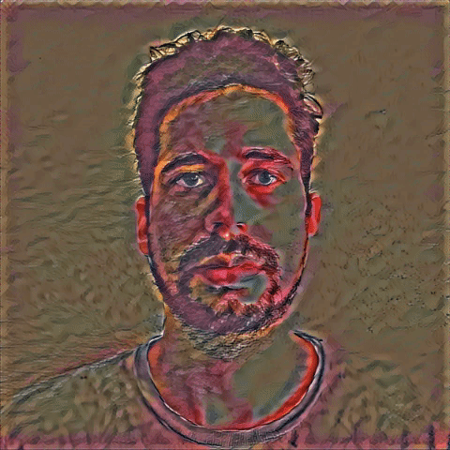
<- Or not pretty

